Slide 1

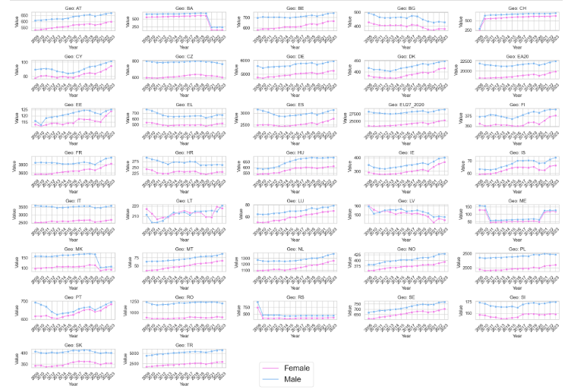

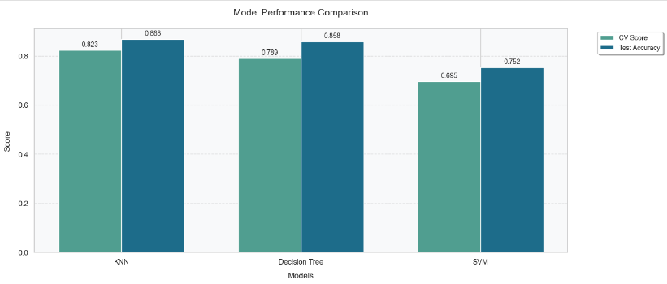
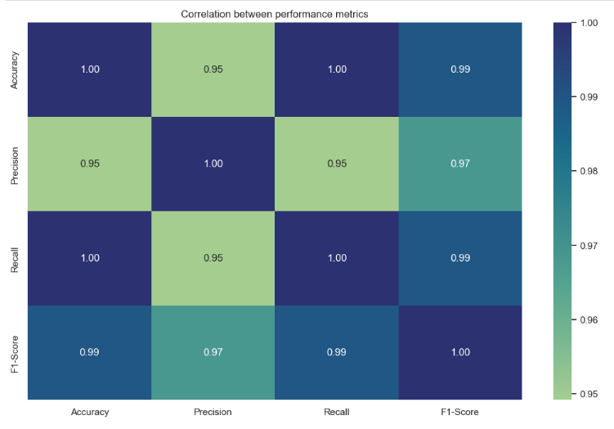
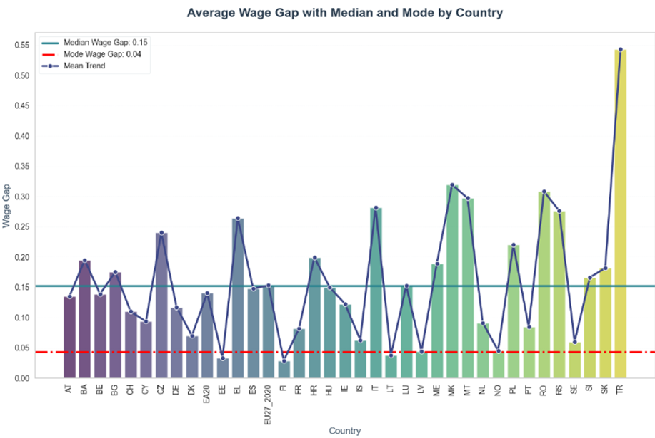
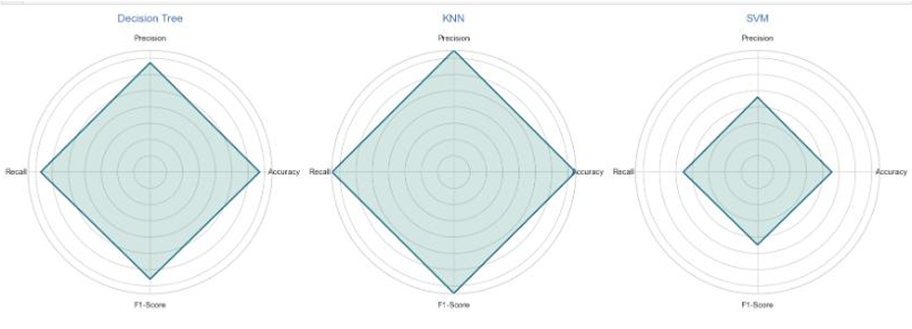
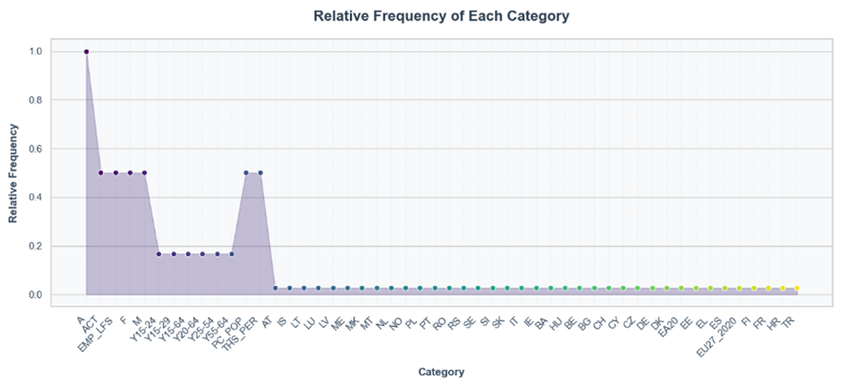


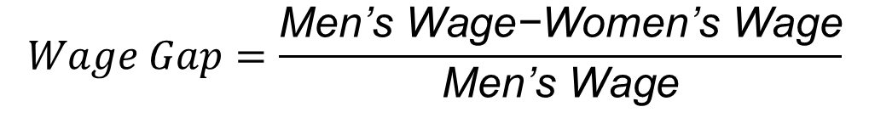
EXPLORING THE GENDER WAGE GAP IN EUROPE: PREDICTIVE MODELING USING KNN, CART, AND SVC
YMBA
INTRODUCTION
CHALLENGES ENCOUNTERED
Additional Cross-Validation
This project tackles Europe’s persistent gender wage gap using Eurostat data and machine learning models. It analyzes factors like gender, age, and employment type to understand income disparities and identify contributors to wage inequality. By providing a quantitative assessment, the study aims to inform policies and organizational practices that promote fairer compensation and gender equity..
Data Quality: Missing values and outliers handled with imputation and filtering; rows with less than 85% completeness removed.
Class Imbalance: Techniques like SMOTE were used to balance wage categories, improving model performance on minority classes.
High Dimensionality: Feature selection using correlation, SelectKBest, and Lasso regularization to improve model efficiency.
Overfitting: Cross-validation and hyperparameter tuning, along with Decision Tree pruning, helped maintain model generalizability.
An additional cross-validation confirmed KNN’s high consistency and stability across folds, reinforcing its reliability in wage gap prediction. The Decision Tree showed variability, highlighting some overfitting, while SVM remained moderately consistent but generally underperformed. This validation underscores KNN’s robustness for accurate wage gap analysis.
Model Performance Comparison
RESULTS AND ANALYSIS
In comparing model performance, the K-Nearest Neighbors (KNN) model proved the most effective for predicting wage gaps, achieving an accuracy of 86.76% with balanced precision and recall, indicating strong generalizability and minimal overfitting. The Decision Tree model stability and struggled particularly in handling complex patterns in wage data. Overall, KNN demonstrated the best balance between accuracy and consistency across wage gap categories, making it the most suitable model for addressing the complexities of wage disparity analysis.
Designed by Freepik
Exploratory Data Analysis (EDA)
The dataset comprises a balanced distribution of categorical variables like gender (50% male, 50% female) and employment indicators. Numerical data reveals a in recent years. This stability in mean and median salaries supports more relable comparisons post-2009. Charts displaying categorical distributions and mean salary trends over time highlight these insights.
BUSINESS DESCRIPTION
Hypothesis: There are significant differences in job opportunities and wages between men and women, caused by social and systemic issues.
General Goal: The goal is to find and understand the reasons for the gender gap in work participation and income. We use data analysis to find these differences and build machine learning models to predict and understand the causes.
Success Criteria: We will be successful if our machine learning models are accurate, help us understand the main reasons for the gap, and can suggest good strategies to reduce these inequalities.
EDA Component | Description | Key Insights | Suggested Visualization
Categorical Variables | Gender, Age, Employment Indicator, Geographic Areas | Balanced distribution (e.g., gender 50/50) | Bar Chart for each categorical variable
Numerical Variables | Wage values (Min, Max, Mean, Median, Mode) | Increase in records and variability post-2009 | Line Chart for mean wage over years
Missing Data | Significant missing values in certain years, especially pre-2009 | Affects trend analysis and accuracy | Heatmap of missing data across years
Outliers | Data spread with outliers from 2003-2004, concentration improves post-2005 | Indicates increased data consistency over time | Boxplots by year for outliers
Feature Selection
Feature selection involved techniques like Correlation, Univariate Selection, Lasso Regularization, and Recursive Feature Elimination (RFE). Lasso and RFE effectively identified the most predictive features, improving model training efficiency. A bar chart visualized the selected features, displaying their importance scores and relevance across the different methods for easy interpretation.
Designed by Freepik
Boxplots for Outliers
Technologies Used
Outlier analysis shows substantial data variability from 2003 to 2004, but as data concentration improves from 2005, the number of outliers reduces. This trend indicates increased consistency in recent years. Boxplots of wage distributions over time reveal how variability has evolved, supporting more accurate wage comparisons in later periods.
We used tools like Python, Pandas, Scikit-Learn for machine learning models, and Matplotlib for creating charts. J\upyter Notebooks was used for the whole data analysis process.
CONCLUSIONS
Wage Gap Analysis
Superior Performance of KNN Model
The KNN model proved to be the most effective and reliable for predicting wage disparities, showing high accuracy (86.76%), balanced precision, and robust generalizability across low, medium, and high wage gap categories.
Model Comparison Highlig\hts
Decision Tree: Achieved competitive accuracy but exhibited overfitting, especially in the medium wage gap category, leading to increased variance in predictions.
SVM: Displayed moderate consistency but struggled with complex data patterns, disparities that need to be addressed.
, organizations can take actionable steps to close the gender wage gap.
The gender wage gap measures the difference in earnings between men and women across different countries and years. This gap is calculated using the average wages for each gender.
Modeling and Evaluation
In predictive modeling, K-Nearest Neighbors (KNN) with k=5k = 5k=5 was the most successful, reaching an accuracy of 86.76% with well-balanced precision and recall. The Decision Tree model achieved an accuracy of 85.82% at a depth of 7 but showed some overfitting. These findings suggest KNN as a robust model for predicting wage gaps, with radar charts highlighting the comparative performance of each model.
Key Formula:
$$Wage Gap=\frac{\text{Men}\text{’}\text{s} \text{Wage}\text{−}\text{Women}\text{’}\text{s} \text{Wage}}{\text{Men}\text{’}\text{s} \text{Wage}}$$
Machine Learning Algorithms: We used K-Nearest Neighbors (KNN), Decision Trees (CART), and Support Vector Machines (SVM) to understand and predict the gender wage gap.
Hyperparameter Tuning and Cross-Validation: We used 5-fold cross-validation to make our models better and prevent overfitting. We also tuned the parameters like k in KNN and max depth in Decision Trees to improve performance.
WHAT HAS BEEN ACCOMPLISHED SO FAR
Data
Dataset: 1776 samples with 27 variables from Eurostat, covering demographics, employment, and wages.
Attributes: Gender, age, employment status, region, wage info, and frequency.
Descriptive Stats: Average salaries show a wage gap; gender distribution is balanced.
Visualization: Charts and heatmaps reveal trends and outliers.
Preparation: Imputed missing values, encoded categories, and scaled features.
Models
Trained and evaluated KNN, CART, and SVC to identify top performers for wage gap predictions.
REFERENCES
Chapman, P., Clinton, J., Kerber, R., Khabaza, T., Reinartz, T., Shearer, C. and Wirth, R. (2000). Step-by-step data mining guide. [online] Available at: https://www.the-modeling-agency.com/crisp-dm.pdf.
Chatgpt.com. (2024). Available at: https://chatgpt.com/share/681cfb33-4726-43ca-8d24-3a2431901e84 Get instant answers, find inspiration, learn something new.
Kazil, J. and Jarmul, K. (2016). Data Wrangling with Python: Tips and Tools to Make Your Life Easier. [online] Google Books. ‘O’Reilly Media, Inc.’ Available at: https://books.google.ie/books?id=XmeDCwAAQBAJ&printsec=copyright&redir_esc=y#v=onepage&q&f=false [Accessed 22 May 2024].
Müller, A.C. and Guido, S. (2017). Introduction to machine learning with Python : a guide for data scientists. Beijing: O’reilly.
Peng, R.D. and Matsui, E. (2015). The art of data science : a guide for anyone who works with data. Victoria, British Columbia: Lulu.com.
Python, R. (n.d.). Using k-Nearest Neighbors (kNN) in Python – Real Python. [online] realpython.com. Available at: https://realpython.com/courses/knn-python/ [Accessed 22 May 2024].
VanderPlas, J. (n.d.). Handling Missing Data | Python Data Science Handbook. [online] jakevdp.github.io. Available at: https://jakevdp.github.io/PythonDataScienceHandbook/03.04-missing-values.html.
Designed by Freepik

